Slide 1

Agentic RAG Chatbot with MCP Project Overview
Author: Naman Varshney.

Slide 2


CONTENTS
1. Project Overview
2. Agent-Based Architecture with MCP
3. System Flow with Message Passing
4. Tech Stack
5. UI Screenshots
6. Challenges & Future Scope

Slide 3
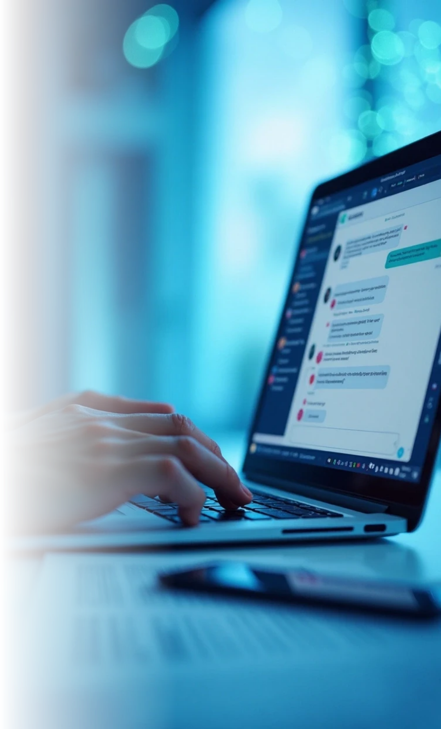
Project Overview
Title
• Agentic RAG Chatbot with Model Communication Protocol
Subtitle
• Conversational Question Answering from Multi-Format Documents
Bullet Points
• Upload docs → Ask questions → Get contextual answers
• Powered by Groq (LLaMA3), FAISS, HuggingFace Embeddings
• Modular architecture with Ingestion, Retrieval, and LLM Agents

Slide 4

Agent-Based Architecture with MCP
Streamlit UI
▼
+-------------------+
| IngestionAgent | ← Loads & splits documents
+-------------------+
▼
+-------------------+
| RetrievalAgent | ← Embeds docs & retrieves top chunks (FAISS)
+-------------------+
▼
+-------------------+
| LLMResponseAgent | ← Groq LLM (LLaMA3) answers using context
+-------------------+
(↔ All communication via MCPMessage protocol)

Slide 5
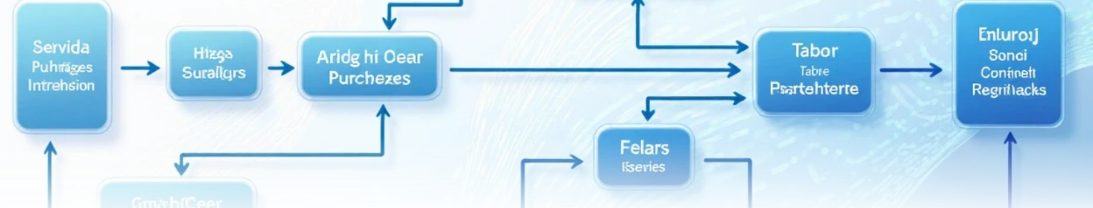
Flowchart
[User Uploads Docs]
↓
[MCPMessage: UPLOAD] → IngestionAgent
↓
[MCPMessage: DOC_CHUNKS] → RetrievalAgent
↓
[User Asks Question]
↓
[MCPMessage: QUERY] → RetrievalAgent → FAISS
↓
[MCPMessage: CONTEXT_RESPONSE] → LLMResponseAgent (Groq)
↓
[MCPMessage: ANSWER] → UI

Slide 6



Tech Stack
1
Title
2
Left column: Backend
3
Right column: Frontend
• Technologies Used
• Python 3.9+
• Streamlit
• Langchain
• HTML/CSS
• FAISS
• Flask (for optional web UI)
• HuggingFace Embeddings
• Groq LLM (LLaMA3-8b-8192)

Slide 7
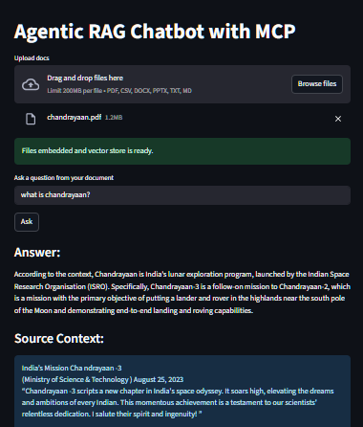

Slide 8


Challenges & Future Scope
Title
• Learnings & Road Ahead
Challenges Faced
• FAISS index persistence between requests
• Session state in Streamlit
• Handling large documents efficiently
• Groq model version deprecation issues
Future Scope
• Streamlit Chat UI (multi-turn history)
• PDF highlighting for source chunks
• Support for audio/video transcripts
• Switchable LLMs (OpenAI, Claude, Gemini, etc.)

Slide 9

Thank You

